Slide 1

Linux System Information and Resource Monitoring Tool
COURSE : OPERATING SYSTEMS AND SYSTEMS PROGRAMMING
COURSE CODE: 25CS2104E
SECTION: 10
BATCH: 20
Branch: CSIT
GUIDED BY: RAGHUPATHI(Assistant professor)
2520090096 - GOUTHAM VIKAS PARIMI
2026-2027

Slide 2
CONTENTS
Abstract
Introduction
Literature Survey
Existing System
Proposed System
Conclusion
Future Scope

Slide 3
ABSTRACT
The Linux System Information and Resource Monitoring Tool is a Linux-based system programming project designed to collect, display, and monitor important system information and resource utilization. The tool provides a simple interface to observe CPU usage, memory utilization, disk usage, running processes, system uptime, and other essential system details. The project demonstrates practical Operating Systems and Systems Programming concepts by interacting with Linux system resources through system calls, POSIX APIs, and the /proc file system. The proposed solution is implemented using C on Ubuntu and periodically collects system information and presents it in a clear and understandable format.

Slide 4
INTRODUCTION
Monitoring system resources is important for understanding the performance and health of a Linux system. CPU, memory, disk space, running processes, and system uptime provide important information about how system resources are being utilized. For beginners, understanding how these resources are managed and accessed by the operating system can be difficult. This project focuses on developing a simple Linux-based application that collects and displays essential system information and resource usage in an organized manner.

Slide 5
Literature survey
Linux provides several system-level mechanisms for accessing and monitoring system information and resources. The /proc file system provides access to information related to CPU, memory, uptime, and running processes maintained by the Linux kernel. File operations can be used to read system information exposed through Linux system files, while POSIX APIs and system calls provide mechanisms for interacting with operating-system resources. Process management, CPU resource management, memory management, and disk management are important areas used for understanding system performance and resource utilization. These Linux mechanisms provide the foundation for developing a system information and resource monitoring tool.

Slide 6
EXISTING SYSTEM
Linux already provides various utilities and commands for monitoring system resources and viewing information about CPU, memory, disk usage, processes, and system uptime. However, existing monitoring utilities may provide large amounts of information that can be difficult for beginners to understand and interpret. Users may need to use different commands or utilities to examine different system resources. Therefore, there is a need for a simple and organized application that collects essential system information and displays it in an understandable format, while also helping students understand the underlying Operating Systems and Systems Programming concepts.

Slide 7
PROPOSED SYSTEM
The proposed system is a Linux System Information and Resource Monitoring Tool developed using C/C++ on Ubuntu. It collects important system information such as CPU usage, memory utilization, disk usage, system uptime, and running-process details through Linux system interfaces. The /proc file system, POSIX/Linux APIs, and system calls are used to retrieve and process the required information. The collected data is displayed through a structured command-line interface and periodically refreshed to provide updated information about system resources and running processes. This provides a simple and efficient way to monitor Linux system performance while demonstrating important Operating Systems and Systems Programming concepts.

Slide 8
CONCLUSION
The Linux System Information and Resource Monitoring Tool provides a simple and efficient way to monitor the overall health and resource utilization of a Linux system. The tool allows users to retrieve and display CPU utilization, memory usage, disk usage, system uptime, running processes, and other system-related information. By using the /proc file system, Linux system files, POSIX APIs, and system calls, the project provides practical exposure to Linux system programming, process management, resource management, and file operations. The expected result is a lightweight command-line monitoring utility that helps users understand how Linux manages system resources.

Slide 9
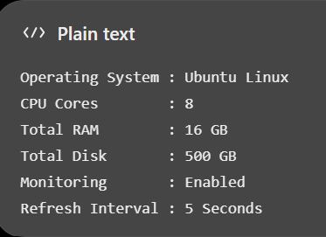
INPUT

Slide 10
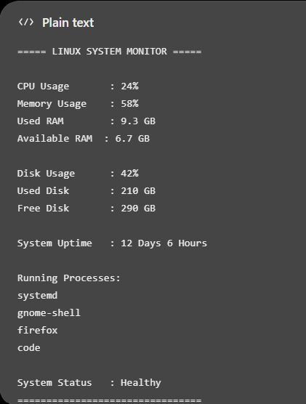
OUTPUT

Slide 11
FUTURE SCOPE
In the future, the Linux System Information and Resource Monitoring Tool can be enhanced with more advanced monitoring features and a graphical user interface. The system can provide improved real-time monitoring of CPU, memory, disk usage, and running processes, along with graphical representation of resource utilization. Additional features such as resource usage history, alerts for high resource consumption, and detailed process analysis can also be incorporated. These enhancements can make the tool more powerful, user-friendly, and useful for monitoring the overall performance and health of Linux systems.

Slide 12
THANK YOU

